Slide 1

Filtering and Normalization of Transcriptomic Data
Understand the concept of a layered ‘grammar of graphics’ and how to use ggplot2
Discuss basics of ‘tidy’ vs messy data and the tidyr package
Filter data to remove lowly expressed genes
Normalize data (to allow between-sample comparisons)

Slide 2
Notes and review (from lecture 2)
R code and packages
Organize code using chunks
Create new chunks by ending a comment line in with 4 dashes
setRepositories() before installing R packages
Use :: to enforce pkg::function relationship
Getting data into R
Rstudio ‘Addins’ let you execute R code interactively
Use tidyverse read_delim() to get data from a file on your computer, into R
Understand the difference between data frame vs matrix
View() to open any data frame or data matrix in table viewer
data() lets you view many datasets that come preinstalled with R
Getting help directly in RStudio
? or help() to retrieve help docs for any function (if package is loaded)
R code can be run directly from help docs
Notes:
Concept of an RStudio Project

Slide 3

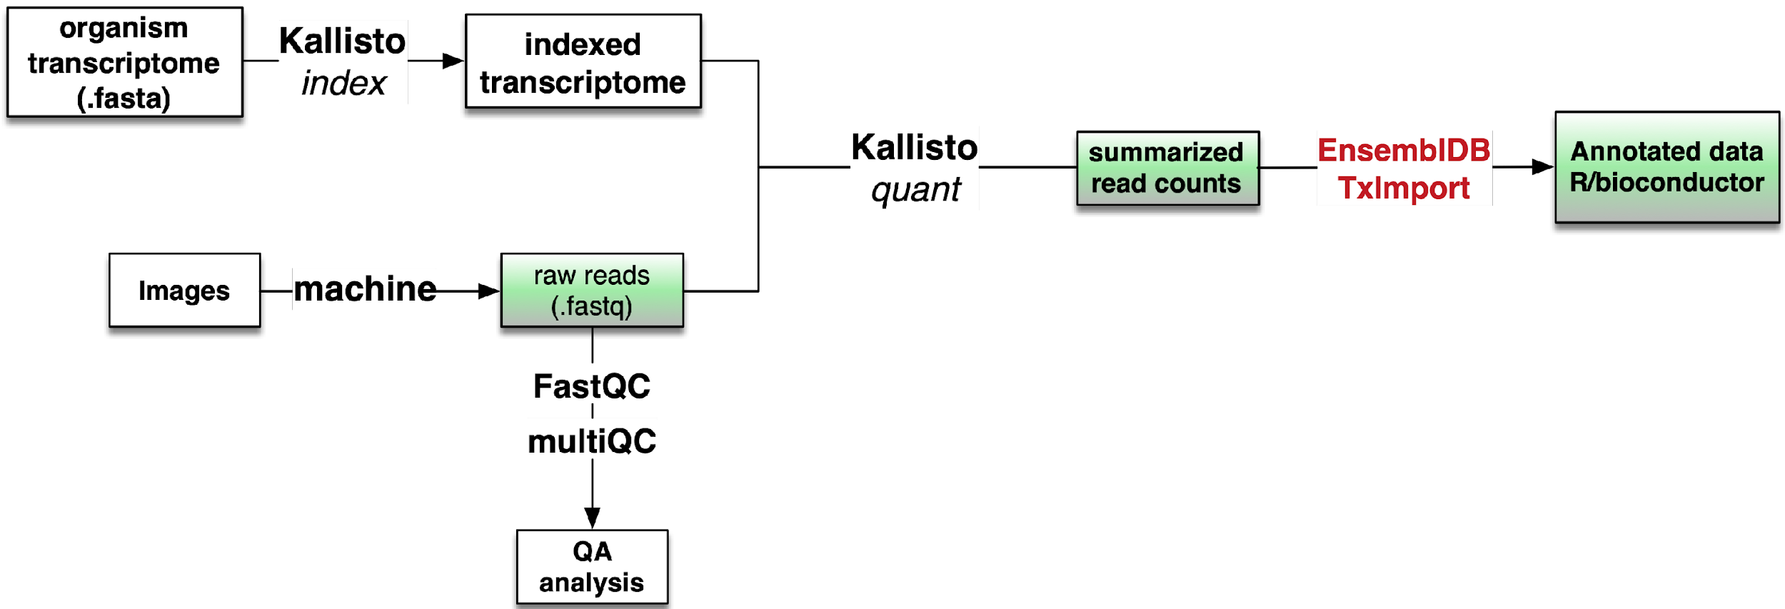
Tracking our progress in this course
Step 1 script
Kallisto
quant
EnsemblDB
tximport

Slide 4
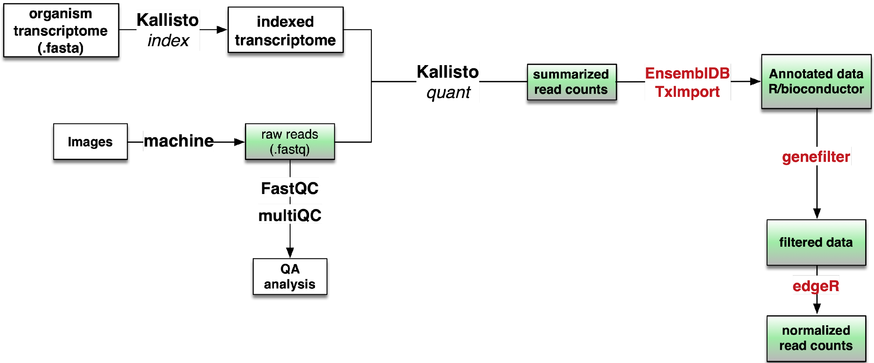
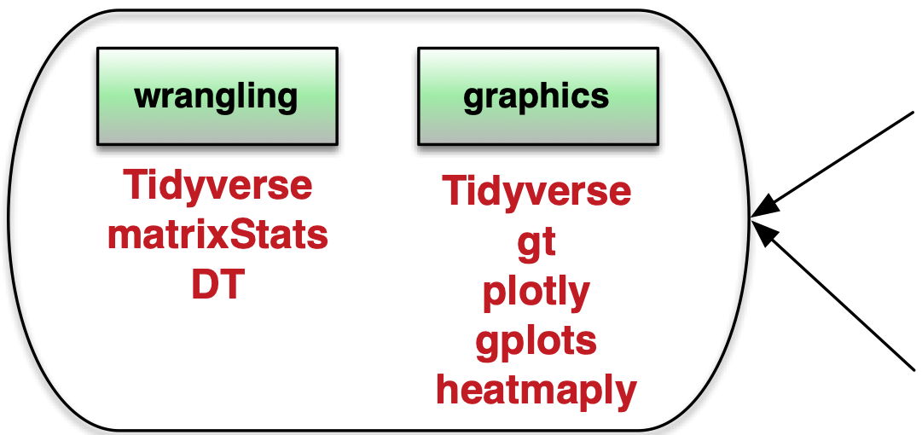
Tracking our progress in this course
Step 1 script
Kallisto
quant
EnsemblDB
tximport
Base R
Step 2
script
edgeR

Slide 5
Point at code

Slide 6
This is a challenging lecture
Data science
RNAseq
Filtering
Tidy data
Normalization
Plotting
Subsetting data

Slide 7
Open the Step 1 script
review ‘the essentials’ chunk

Slide 8
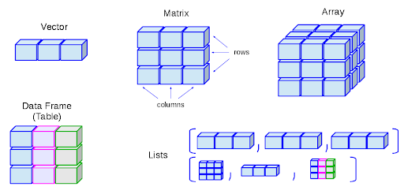
Data types in R
Matrix
Array
Vector
rows
columns
Dataframe
List

Slide 9

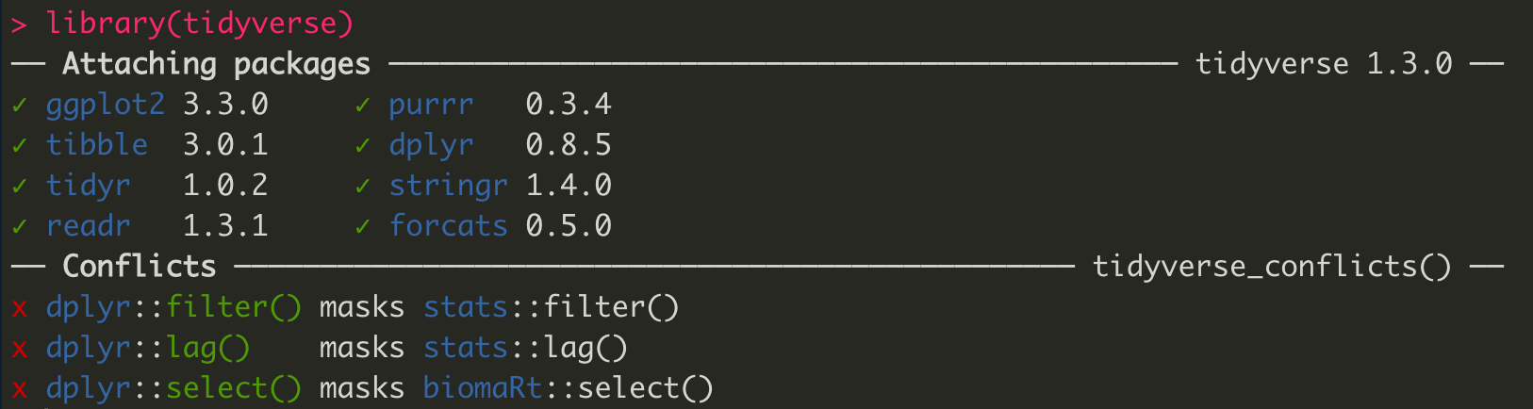
The Tidyverse

Slide 10



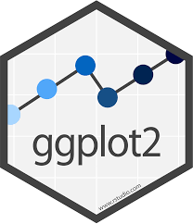
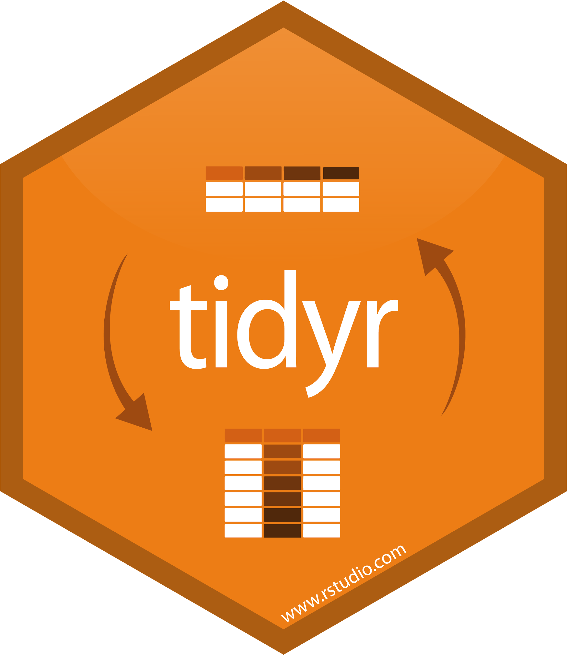





The Tidyverse
rename()
select()
as_tibble()
ggplot()
read_tsv()
Hadley Wickham
Chief Scientist, RStudio
pivot_longer()

Slide 11
Open the Step 2 script
install packages, browse Txi lists

Slide 12
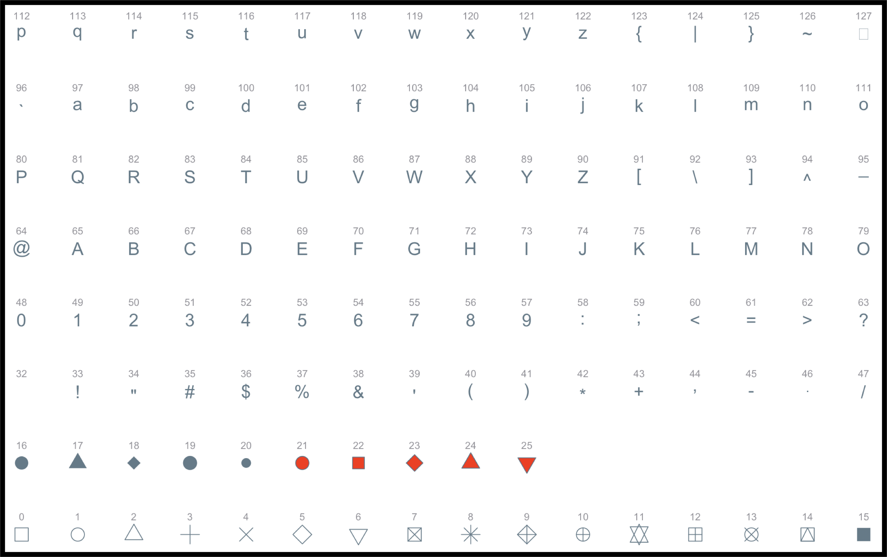
ggplot2 - shape parameter

Slide 13
ggplot2 themes
theme(
line,
rect,
text,
title,
aspect.ratio,
axis.title,
axis.title.x,
axis.title.x.top,
axis.title.x.bottom,
axis.title.y,
axis.title.y.left,
axis.title.y.right,
axis.text,
axis.text.x,
axis.text.x.top,
axis.text.x.bottom,
axis.text.y,
axis.text.y.left,
axis.text.y.right,
axis.ticks,
axis.ticks.x,
axis.ticks.x.top,
axis.ticks.x.bottom,
axis.ticks.y,
axis.ticks.y.left,
axis.ticks.y.right,
axis.ticks.length,
axis.ticks.length.x,
axis.ticks.length.x.top,
axis.ticks.length.x.bottom,
axis.ticks.length.y,
axis.ticks.length.y.left,
axis.ticks.length.y.right,
axis.line,
axis.line.x,
axis.line.x.top,
axis.line.x.bottom,
axis.line.y,
axis.line.y.left,
axis.line.y.right,
legend.background,
legend.margin,
legend.spacing,
legend.spacing.x,
legend.spacing.y,
legend.key,
legend.key.size,
legend.key.height,
legend.key.width,
legend.text,
legend.text.align,
legend.title,
legend.title.align,
legend.position,
legend.direction,
legend.justification,
legend.box,
legend.box.just,
legend.box.margin,
legend.box.background,
legend.box.spacing,
panel.background,
panel.border,
panel.spacing,
panel.spacing.x,
panel.spacing.y,
panel.grid,
panel.grid.major,
panel.grid.minor,
panel.grid.major.x,
panel.grid.major.y,
panel.grid.minor.x,
panel.grid.minor.y,
panel.ontop,
plot.background,
plot.title,
plot.title.position,
plot.subtitle,
plot.caption,
plot.caption.position,
plot.tag,
plot.tag.position,
plot.margin,
strip.background,
strip.background.x,
strip.background.y,
strip.placement,
strip.text,
strip.text.x,
strip.text.y,
strip.switch.pad.grid,
strip.switch.pad.wrap,
...,
complete = FALSE,
validate = TRUE
)
Complete themes
theme_gray()
theme_bw()
theme_light()
theme_dark()
theme_minimal()
theme_classic()
theme_void()

Slide 14
You are not restricted to ggplot’s ‘complete themes’

Slide 15

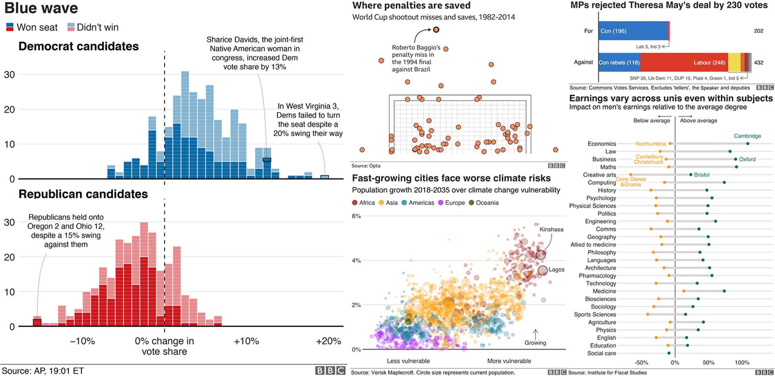
theme
bbplot R package

Slide 16
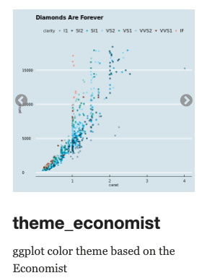
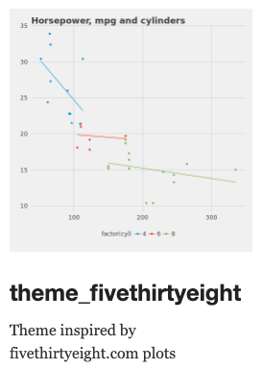
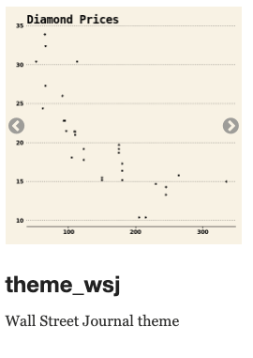
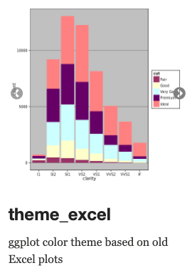
ggthemes package
ggthemes R package (available on CRAN)

Slide 17
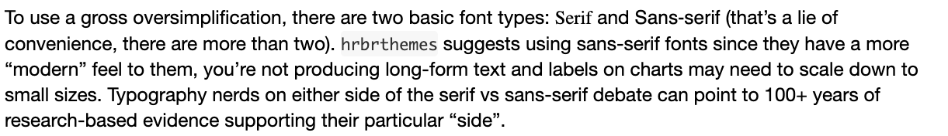
hrbrthemes package
hrbrthemes R package (available on CRAN)

Slide 18
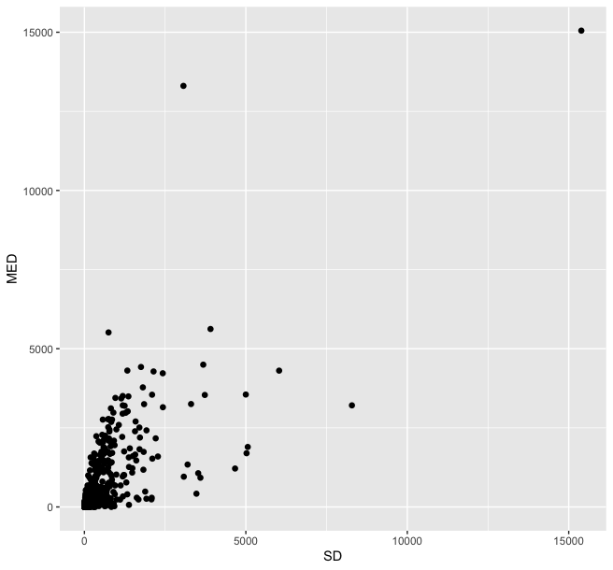
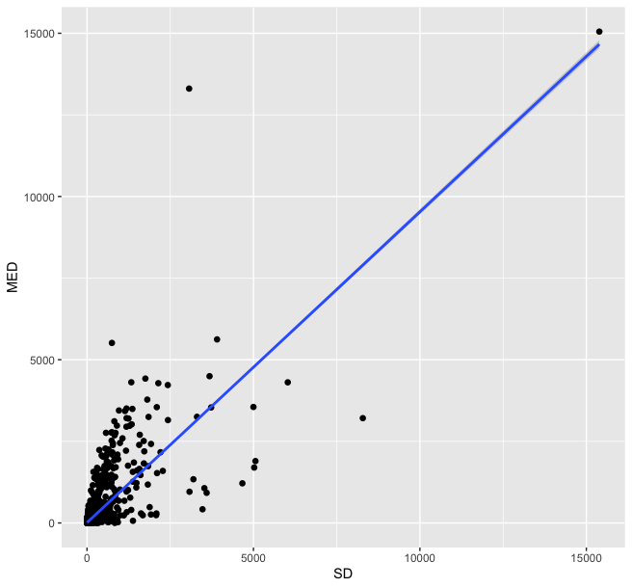
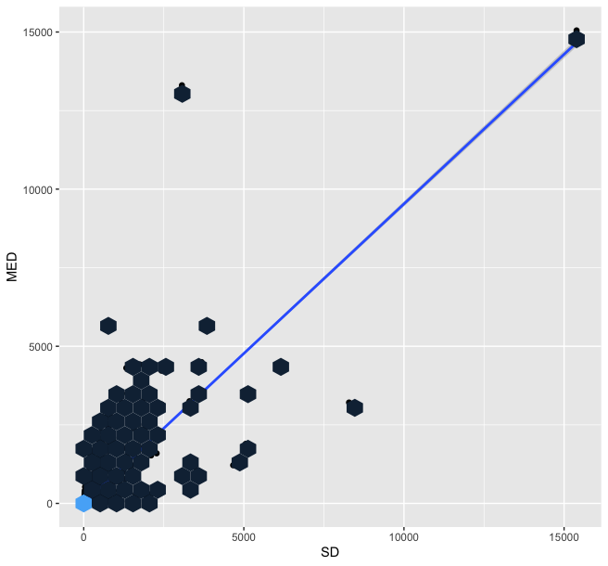
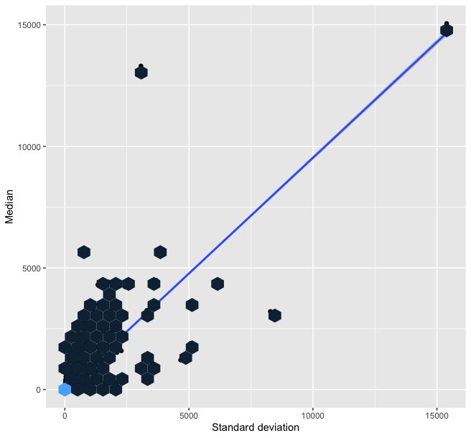

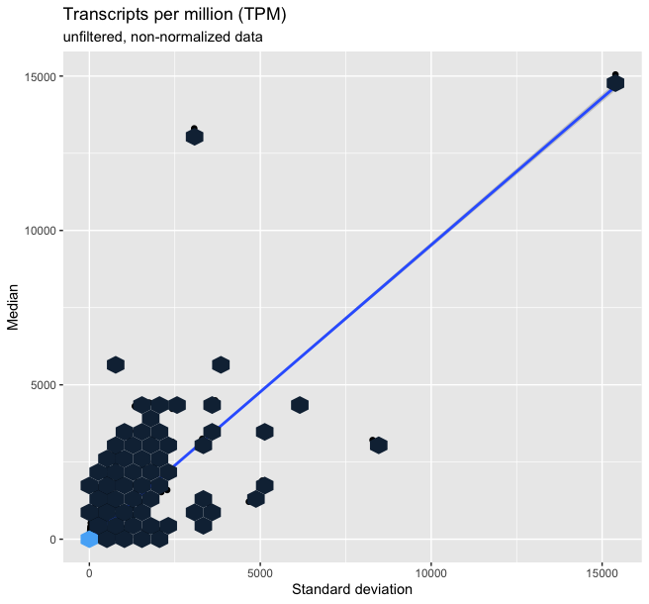
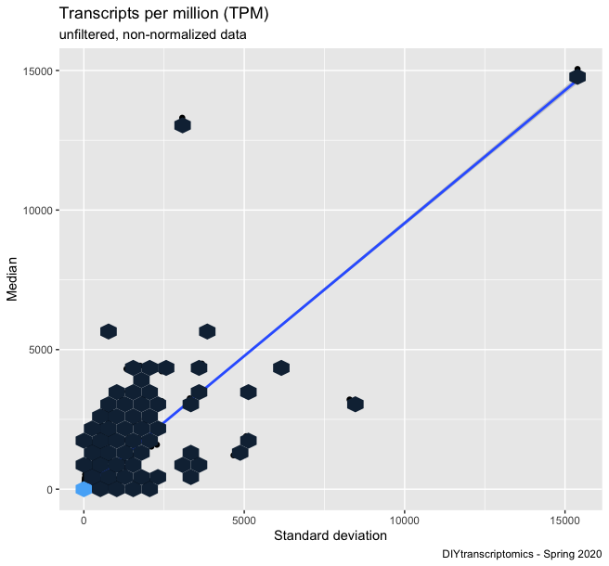
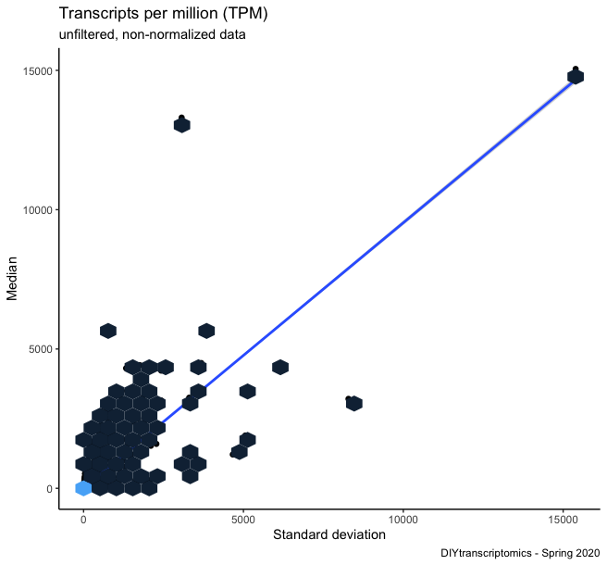
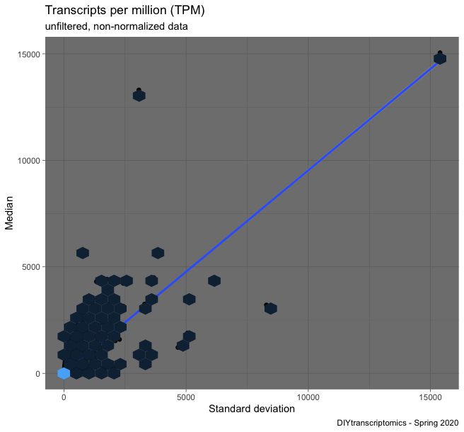

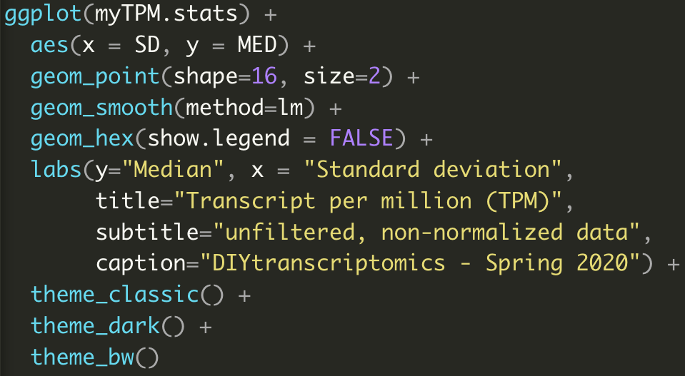
ggplots are constructed in layers

Slide 19
Advantages of a layered grammar of graphics
Users can iteratively update a plot, changing specific elements as needed
Even high-level aspects of a plot can be changed
Layers allow plots to be overplayed (e.g. box plot with points shown)
Layers also make it easy to use # to toggle layers on/off
Default arguments for each layer minimize the need for users to dictate details
For software developer, easy to develop new functionality (e.g. stat transformation)

Slide 20
Tidy data philosophy
“A dataset is messy or tidy depending on how rows, columns and tables are matched up with observations, variables and types”
Each variable forms a column
Each observation forms a row
Each type of observational unit forms a table
“All happy families are alike; each unhappy family is unhappy in its own way”
- Leo Tolstoy, Anna Karenina
messy data is anything that doesn’t meet these criteria!

Slide 21
gene expression data is always ‘messy’
Gene | treatment 1 | treatment 2 | treatment 3
gene A | 5 | 10 | 10
gene B | 1000 | 1100 | 1050
messy
Each variable forms a column
Each observation forms a row
Each type of observational unit forms a table

Slide 22

gene expression data is always ‘messy’
Gene | treatment 1 | treatment 2 | treatment 3
gene A | 5 | 10 | 10
gene B | 1000 | 1100 | 1050
messy
Gene | treatment | Expression
gene A | treatment 1 | 5
gene A | treatment 2 | 10
gene A | treatment 3 | 10
gene B | treatment 1 | 1000
gene B | treatment 2 | 1100
gene B | treatment 3 | 1050
tidyr
pivot_longer()
tidy

Slide 23

gene expression data is always ‘messy’
Gene | treatment 1 | treatment 2 | treatment 3
gene A | 5 | 10 | 10
gene B | 1000 | 1100 | 1050
messy
Gene | treatment | Expression
gene A | treatment 1 | 5
gene A | treatment 2 | 10
gene A | treatment 3 | 10
gene B | treatment 1 | 1000
gene B | treatment 2 | 1100
gene B | treatment 3 | 1050
tidyr
pivot_wider()
tidy

Slide 24
Tidy data is ideal for graphing
Each variable gets its own column
Gene | treatment | Expression
gene A | treatment 1 | 5
gene A | treatment 2 | 10
gene A | treatment 3 | 10
gene B | treatment 1 | 1000
gene B | treatment 2 | 1100
gene B | treatment 3 | 1050
Each observation gets its own row
Values are easily retrieved as single vector

Slide 25
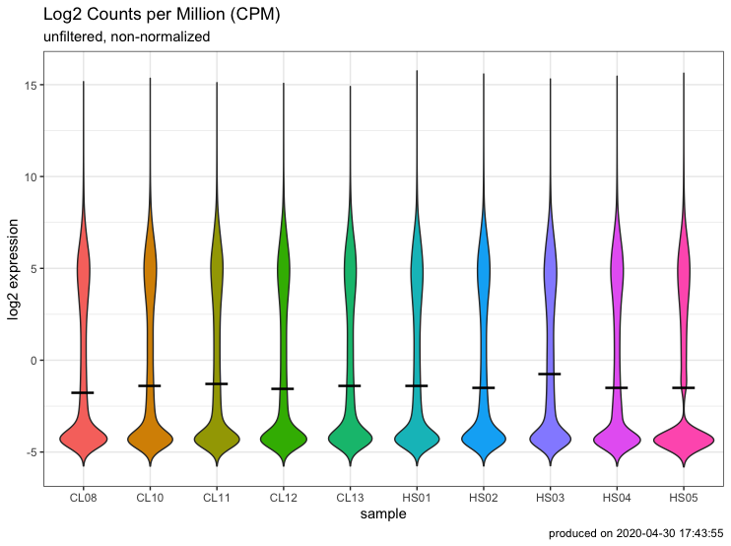
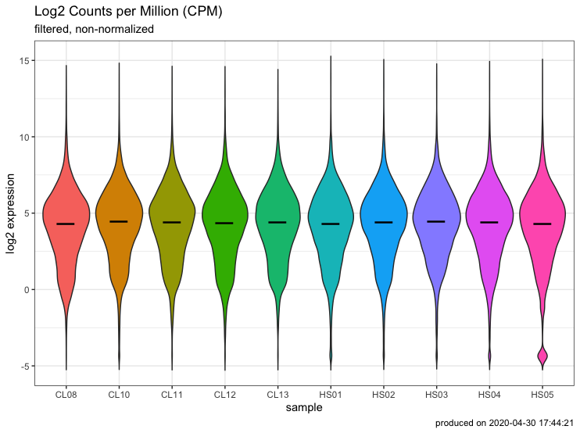
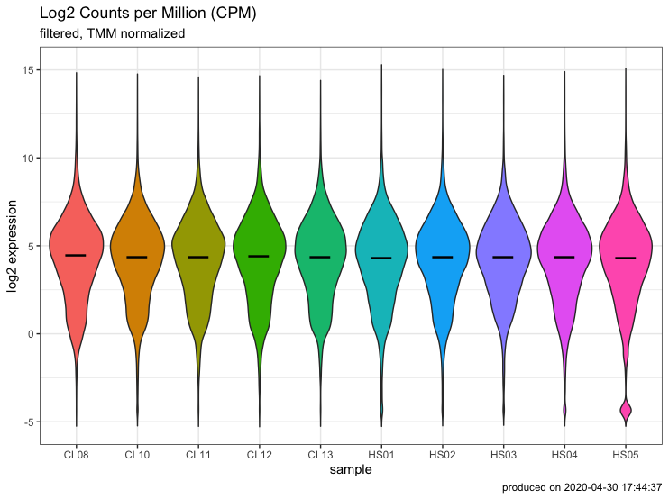
Visualizing the Step 2 script
Raw
Filtered
Normalized
Base R
rowSums()
edgeR::
calcnormfactors
as_tibble()
as_tibble()
as_tibble()
pivot_longer()
pivot_longer()
pivot_longer()
ggplot()
ggplot()
ggplot()

